Slide 1
4 BIT BINARY CODE CONVERTER
Digital System Design Project
Presented By T Tushar Shenoy
ECE’25 NMAMIT

Slide 2
What is a 4 Bit Binary Code Converter?
A 4-bit binary code converter is a circuit that can convert a 4-bit binary code representation from one form to another
The digital data is represented, stored and transmitted as group of bits, this group of bits is also called as binary code
Code converters are used to convert the information into the desired code
The four types of codes which are included in this project are Binary, Excess-3, BCD and Gray code
.

Slide 3
Objective and Types of Binary Codes in this Project
Objective: To design and implement a circuit which will perform 4 different binary code conversions depending on the initial inputs
Types of Binary Codes :
1) Gray Code: non-weighted code, successive gray code differs in one bit position -unit distance code
2) Excess-3 Code: non-weighted code-obtained by adding 3 to BCD
3) BCD: Binary Coded Decimal-weighted codes, every digit of a decimal number is expressed by a separate group of 4-bits

Slide 4
Circuit Design
Components Used
Sl No | Component | Quantity
1 | IC 74153 (Dual 4-input multiplexer) | 8
2 | IC 74139 (Dual 2-to-4 line Decoder) | 1
3 | IC 7432 (Quad OR Gate) | 1
4 | IC 7486 (Quad XOR Gate) | 1
5 | IC 7408 (Quad 2 input AND gate) | 1
6 | IC 7404 (Hex Inverter) | 2
7 | LM7805 IC (5V voltage regulator) | 1
8 | Cathode 7-segment display | 4
9 | Diodes (1N4007) | 16
10 | 6 Pin Button Switch | 6
11 | 9V battery | 1

Slide 5
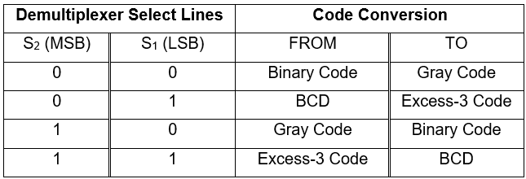
Code Conversion Table
Note: For Truth Table of the codes and more Information Go through the Project Report given in the Description.

Slide 6
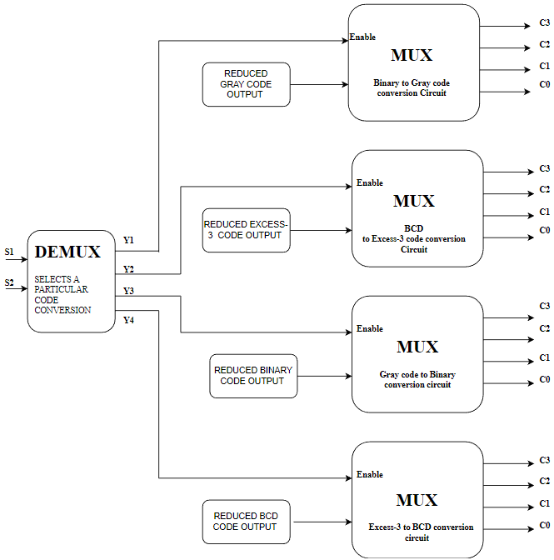
Block Diagram

Slide 7
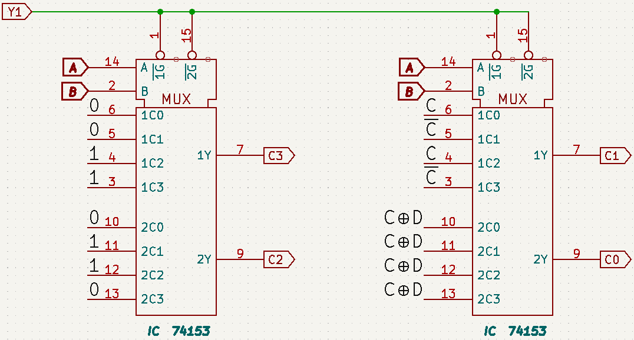
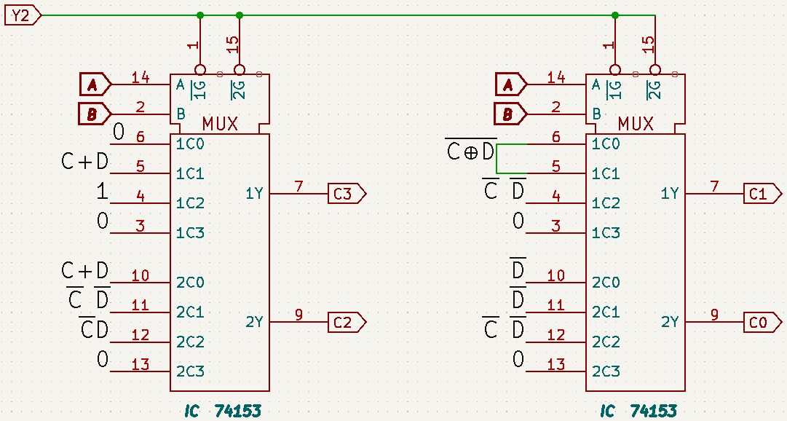
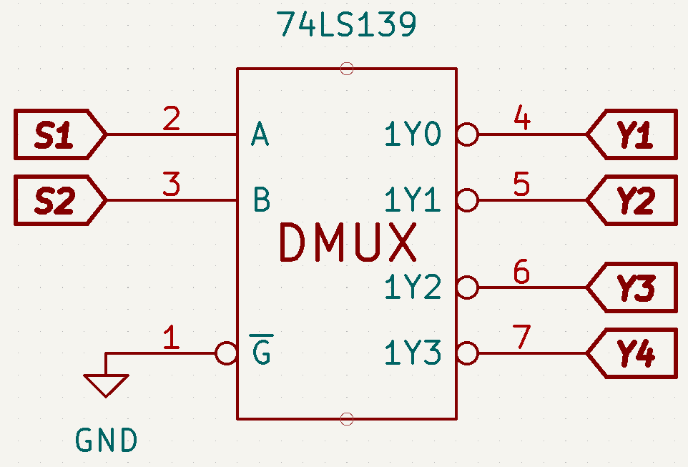
Circuit Diagram
Demultiplexer Circuit
Binary to Gray code conversion Circuit
BCD to Excess-3 code conversion Circuit

Slide 8
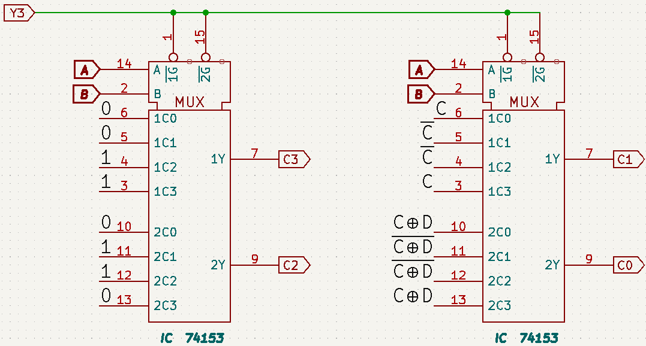
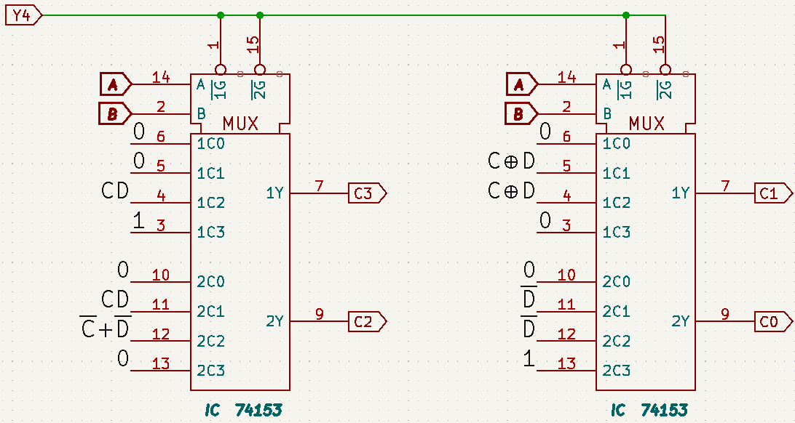
Gray code to Binary conversion Circuit
Excess-3 code to BCD conversion Circuit

Slide 9
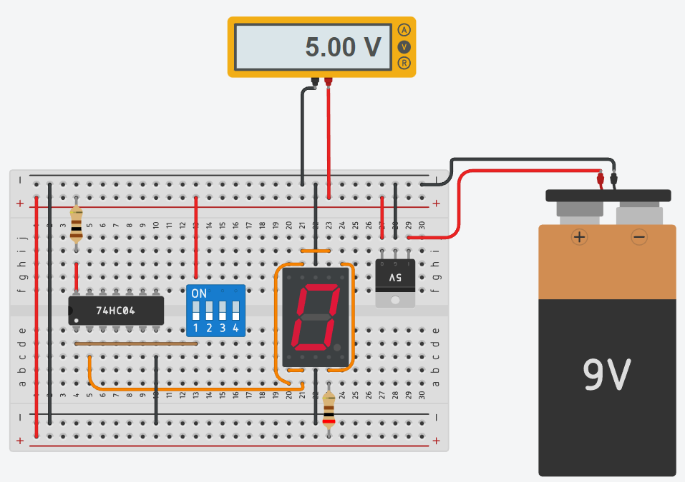
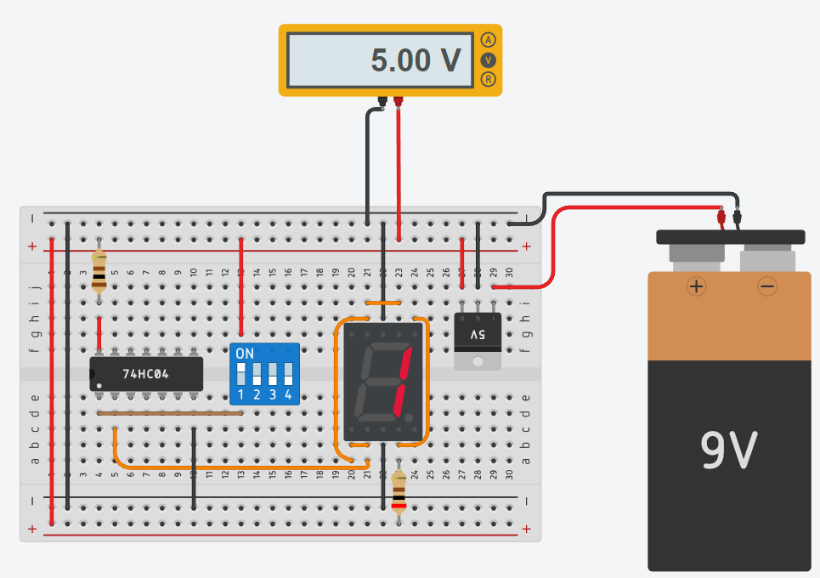
Logic used to Display 0s and 1s on a 7 segment display

Slide 10
Working:
The 4-bit binary code converter Circuit using Demultiplexer (DEMUX) and Multiplexer (MUX) works as follows:
Initially the DEMUX is used to select a Particular Conversion out of 4 different conversion, the output of the DEMUX is applied to the enable of the MUX. The select lines of the DEMUX determine the Conversion which has to be performed.
The inputs A, B, C, D is given once after selecting the conversion which is needed to be performed.
The logic Gates Like OR, NOT, AND, XOR are Used to Perform Operations on inputs C and D and the outputs of the Logic Gates is then applied to the inputs of the MUX.
The MUX is used to map the Reduced outputs of a particular code to the output and the conversion to gray code or Excess-3 code or binary is performed. The selection lines of the MUX that is A and B determine the mapping of the binary code to the gray code or Excess-3 code.
The outputs of the MUX represent the converted code in the desired format.
The Converted output is displayed on the 7 Segment displays along with the LEDs.

Slide 11
PROJECT DEMONSTRATION

Slide 12
THANK YOU
Connect on LinkedIn https://www.linkedin.com/in/t-tushar-shenoy

